Slide 1
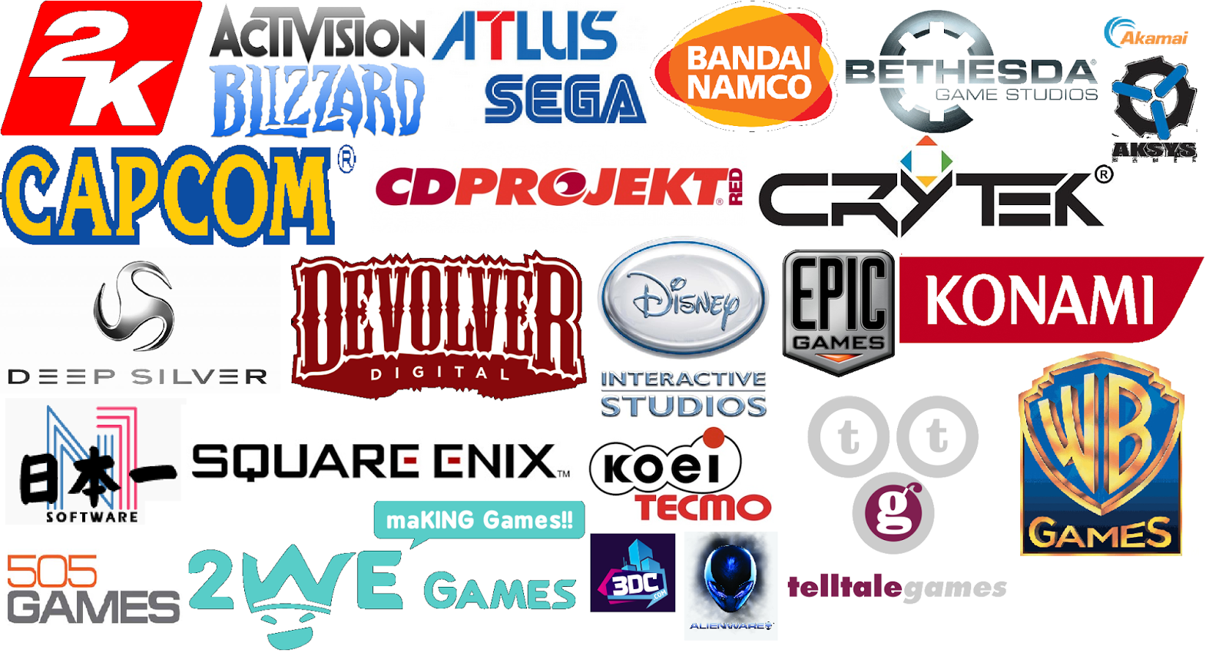

Video Game Sales Database Group 8
Tae Yong Namkoong, Hyuk Joon Yang, Nathan Sackett
CS 564, Summer 2020 : Professor Nguyen

Slide 2
STEP 1 : PICK AN APPLICATION

Slide 3
1. Motivation and Domain
I. Motivation
Analyze and predict sales trends in game market
Video game market is rapidly growing and expanding
Provide meaningful demographic data in gaming industry
Integrate relations between categorical information through queries
Notes:
Brief explanation

Slide 4
1. Motivation and Domain
II. The Need for Database & DBMS
Millions of games are sold every year
To track the success of a game, platform, genre, or company, necessary to look in context of its competition in various categories
Efficient data storage/retrieval & data processing for users
Intuitive UI/UX allows users to extract meaningful information from raw data through queries
Fast, and flexible data access and data manipulation

Slide 5
2. Application Description
The Type of Application
- Standalone application
Stored data access/manipulation/user queries.
Supports access/modification of data as well as scalability to large datasets (big data)

Slide 6
2. Application Description
III. Datasets
Obtained videogamessales.csv from Kaggle.com
Dataset contains the names of video games, the platform on which they are released, the year of publication, genre, publisher, and sales data for each region.
Reason:
11 columns of data and 16591 rows
Dataset well-organized and clean
Single source 🡪 no multiple source integration will be required
Notes:
Brief explanation

Slide 7
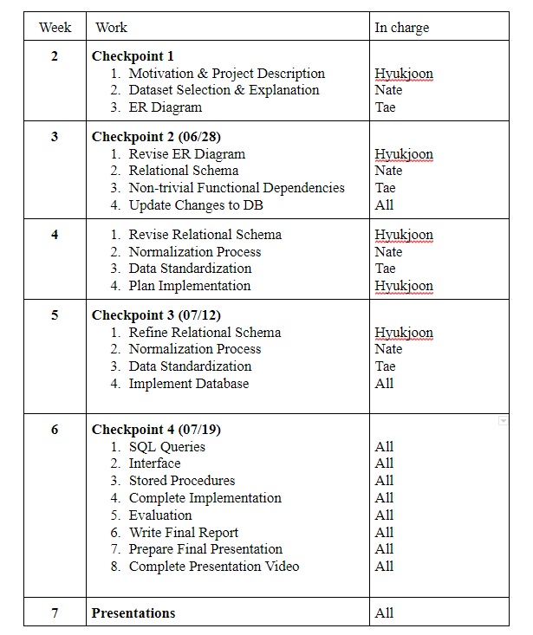
3. Project Management

Slide 8
STEP 2 : CONCEPTUAL DESIGN

Slide 9
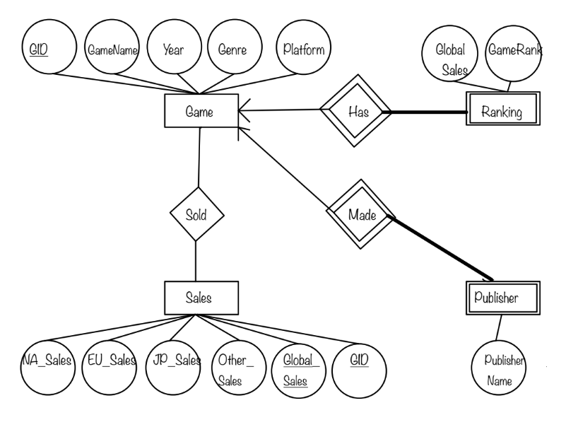
1. ER Diagram
Notes:
Important

Slide 10
STEP 3 : RELATIONAL SCHEMA

Slide 11
1. Entity Sets
TABLE 1. Game (GID: BIGINT, GameName: String, Platform: String, Year: String, Genre: String)
GID – BIGINT;
GameName - String; ≤ 135 Characters
Platform – String; ≤ 15 Characters
Year - String ≤ 5 characters (Some games has no data for year)
Genre - String; (Action, Adventure, Fighting, Misc, Platform, Puzzle, Racing, Role-Playing, Shooter, Simulation, Sports, Strategy)
Primary Key : GID
Notes:
Important

Slide 12
1. Entity Sets
TABLE 2. Sales (GID: int, NA_Sales: double, EU_Sales: double, JP_Sales: double, Other_Sales: double, Global_Sales: double)
GID – BIGINT; (Primary)
NA_Sales – Positive double; 0.0 ≤ Sales ≤ 100,000
EU_Sales – Positive double; 0.0 ≤ Sales ≤ 100,000
JP_Sales – Positive double; 0.0 ≤ Sales ≤ 100,000
Other_Sales – Positive double; 0.0 ≤ Sales ≤ 100,000
Global_Sales – Positive double; 0.0 ≤ Sales ≤ 100,000 (Primary)
Primary Key : GID, Global_Sales
Foreign Key : (GID) references Game(GID)
Notes:
Important

Slide 13
1. Entity Sets
TABLE 3. Publisher (GID: int, PublisherName: String)
GID – BIGINT; ≤ # of rows in table (Primary)
PublisherName - String; ≤ 50 Characters
Primary Key : GID
Foreign Key : (GID) references Game(GID)
Notes:
Important

Slide 14
1. Entity Sets
TABLE 4. Ranking (GID: int, GameRank: int, Global_Sales: double)
GID – Unique Ranking; ≤ # of rows in table (primary)
GameRank - Unique Ranking; ≤ # of rows in table (Primary)
Global_Sales – Positive double; 0.0 ≤ Sales ≤ 100,000
Primary Key : GID
Foreign Key : (GID, Global_Sales) references Sales(GID, Global_Sales)
Notes:
Important

Slide 15
STEP 4 : NORMALIZATION PROCESS

Slide 16
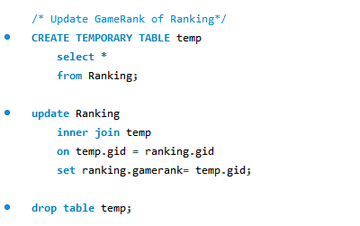
ENSURE 3NF
Games Table was in neither BCNF nor 3NF initially
PROBLEM: GameName was a non-unique, non-candidate key because there were duplicate elements with many non-trivial functional dependencies
ex) There were some games with identical names published in the same year (duplicates & data anomalies)
SOLUTION : We made all columns (attributes) functionally dependent on the GID which was the unique ranking assigned to each game
Now GID is primary key
For Sales table: Global_Sales is sum of all regional sales so we had to make both GID and Global_Sales as primary key
Guarantees lossless decomposition & dependency preserving
Notes:
Important

Slide 17
NON-TRIVIAL FUNCTIONAL DEPENDENCIES
RELATION | FUNCTIONAL DEPENDENCIES | 3NF ACHIEVED?
Game | GID → GameName, Platform, Year, Genre GameName, Platform → GID | Yes, GID is the candidate key in the relation GID is a prime attribute
Sales | GID,Global_Sales → NA_Sales, EU_Sales, JP_Sales, Other_Sales NA_Sales, EU_Sales, JP_Sales, Other_Sales → Global_Sales | Yes, (GID, Global_Sales) is a superkey, and Global_Sales is a prime attribute.
Publisher | GID →PublisherName | Yes, Relation with 2 attributes is always in BCNF, which means it is also 3NF
Ranking | GID → GameRank, Global_Sales | Yes, GID is the candidate key in the relation
Notes:
Important

Slide 18
Step 5,6: Pick a DBMS and implement database
BACK-END DBMS: MySQL
Relational DBMS based on Structured Queries
Scalable through multi-threading 🡺 supports big data
Simple syntax & DDL/DML covered in lecture
GUI Support (MySQL Workbench) 🡺 Easy to Use & high functionality
Bridges gap between logical model and machine (physical data independence & logical data independence)
Supports .csv

Slide 19
Step 5,6: Pick a DBMS and implement database
2. FRONT-END GUI: JavaFX
Team members have experience from CS400
FXML intuitive & easy to use
Can be integrated with back-end MySQL
Enables UI tests
Built-in functionalities (buttons, frames, panels, etc)

Slide 20
EVALUATION (TESTING)
Objective:
Make sure that games can be added, removed, searched for, global sales correctly increases upon incrementing regional sales, and rank will update after changing sales data.
Method:
Calculate the expected result based on CSV file
Compare the result from the database with expected result
Repeat this comparison for every stored procedures and queries used in the application

Slide 21
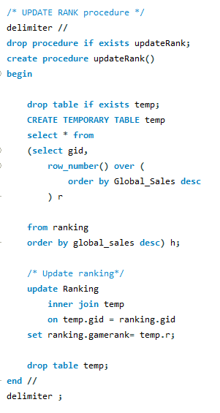
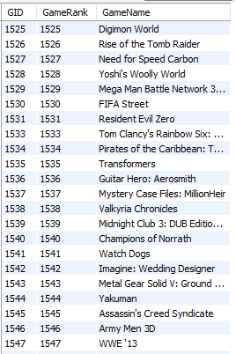
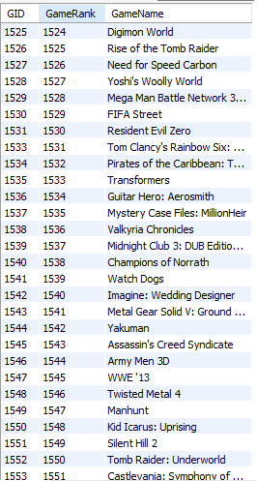
STORED PROCEDURES: updateRank

Slide 22
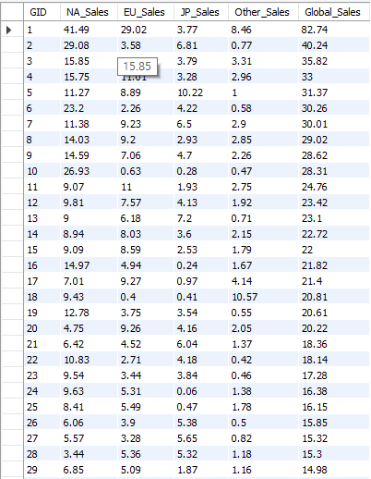
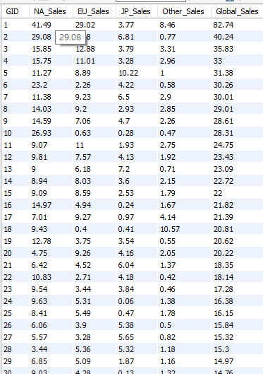
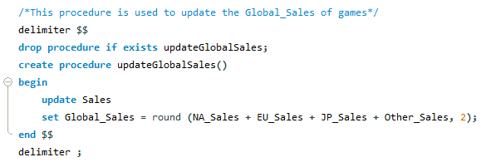
STORED PROCEDURES: updateGlobalSales
Notes:
Briefly explain the function

Slide 23
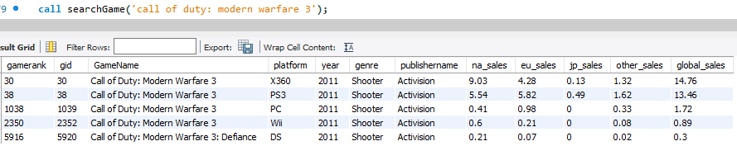
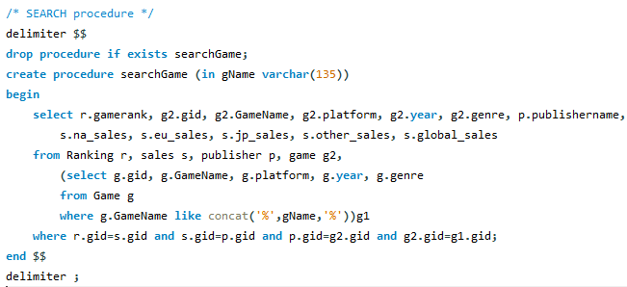
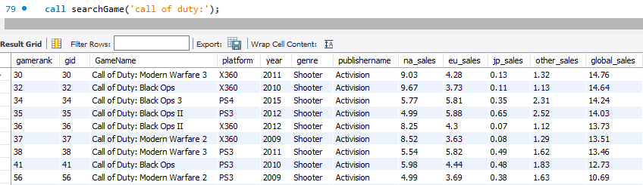
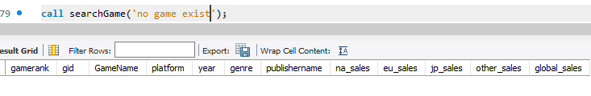
STORED PROCEDURES: searchGame
Notes:
Briefly explain the function

Slide 24
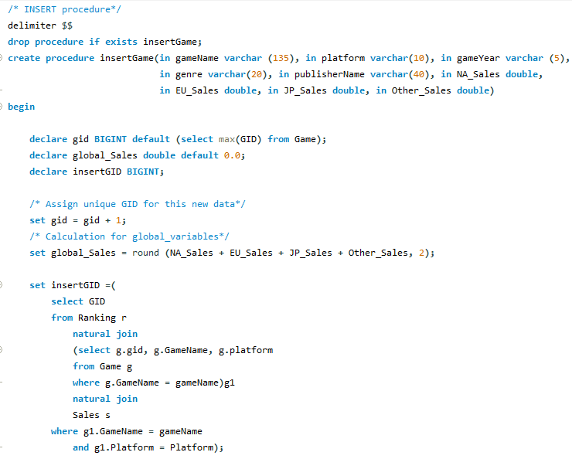
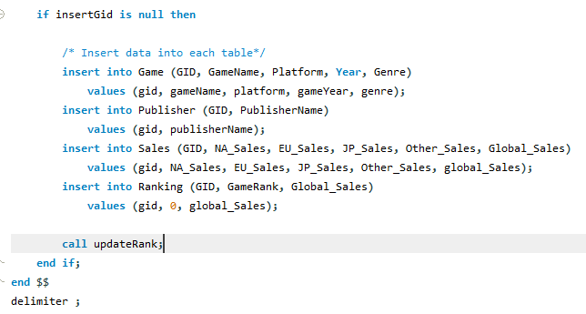
STORED PROCEDURES: insertGame
Notes:
Briefly explain the function

Slide 25

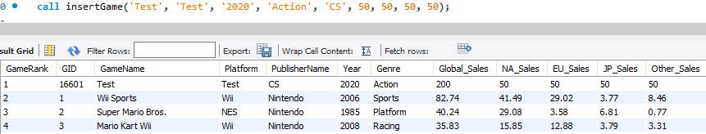
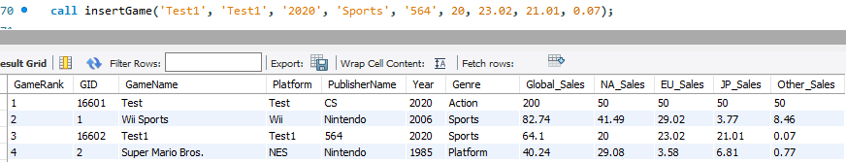
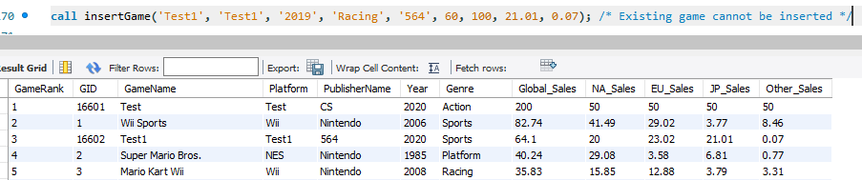
STORED PROCEDURES: insertGame (cont.)
Notes:
Briefly explain the function

Slide 26
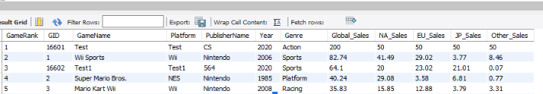
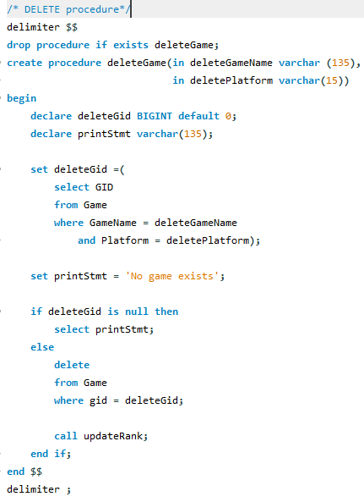
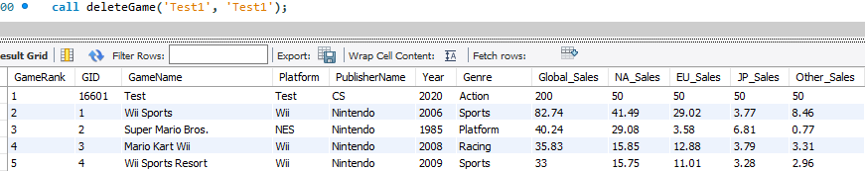
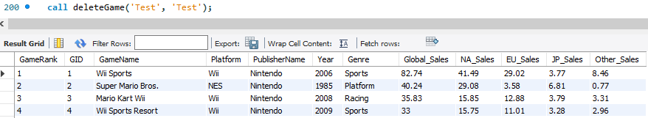
STORED PROCEDURES: removeGame
Notes:
Briefly explain the function

Slide 27
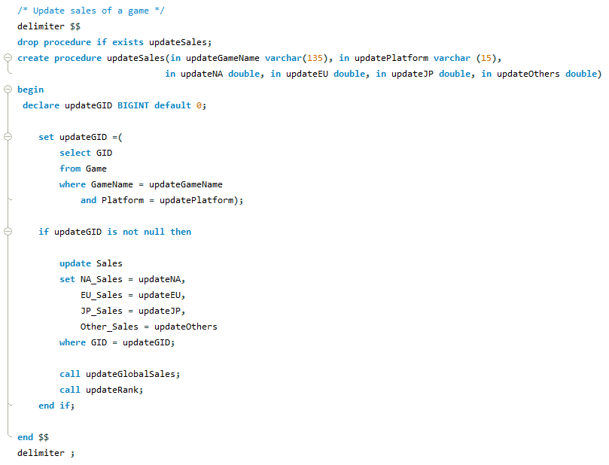
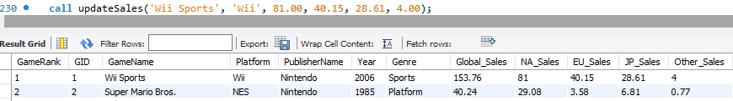
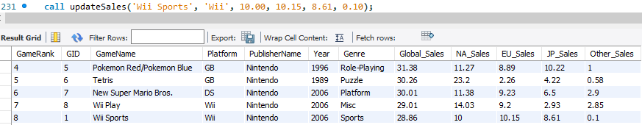
STORED PROCEDURES: updateSales
Notes:
Briefly explain the function

Slide 28
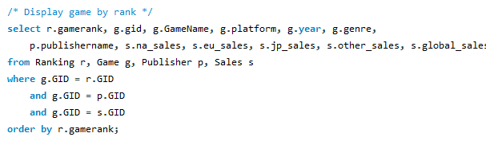
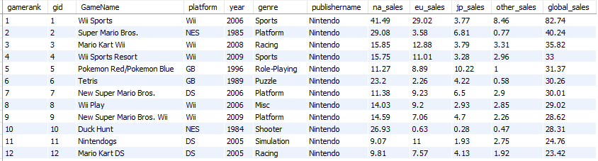
QUERIES:
Display games order by rank
Notes:
Briefly explain the function and evaluation

Slide 29
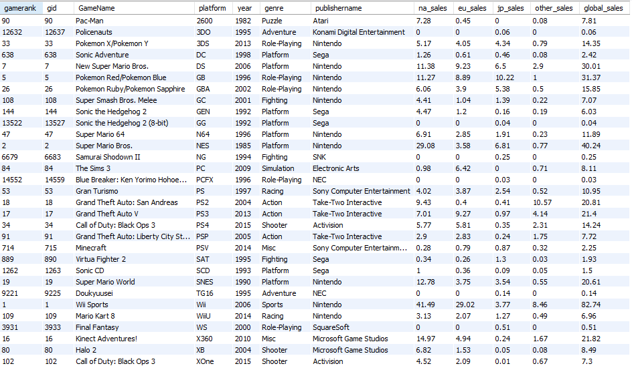
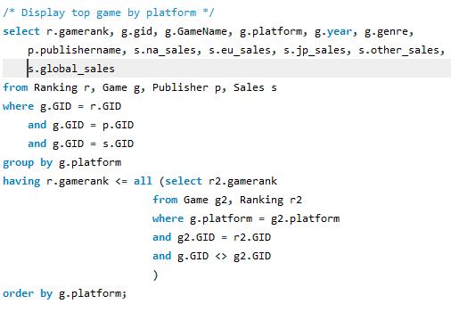
QUERIES:
Display top game per platform
Notes:
Briefly explain the function and evaluation

Slide 30
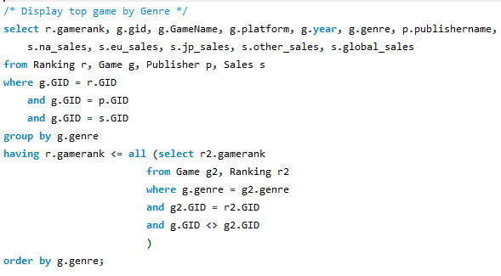
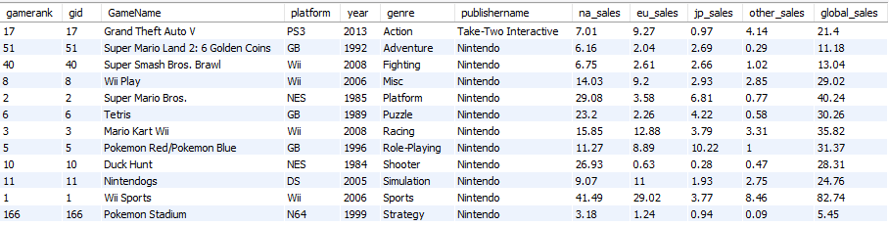
QUERIES:
Display top game per genre
Notes:
Briefly explain the function and evaluation

Slide 31
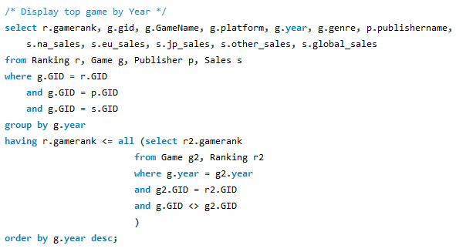
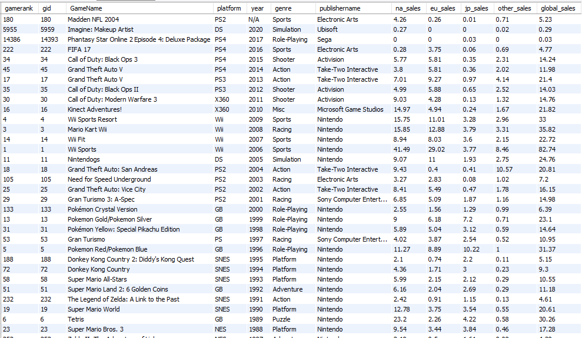
QUERIES:
Display top game per year
Notes:
Briefly explain the function and evaluation

Slide 32
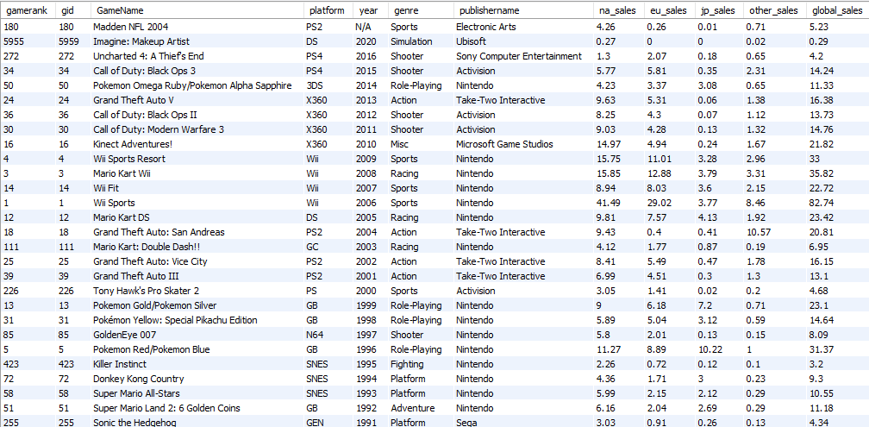
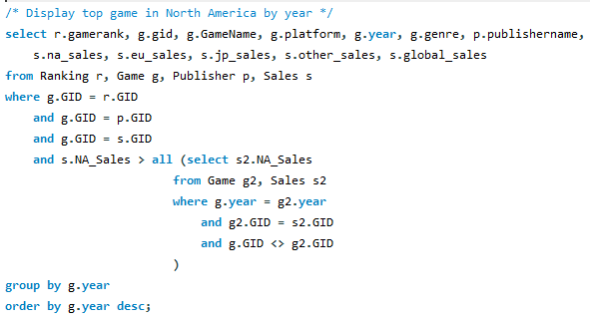
QUERIES:
Display top game in North America by year
Notes:
Briefly explain the function and evaluation

Slide 33
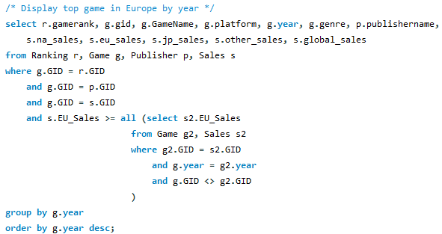
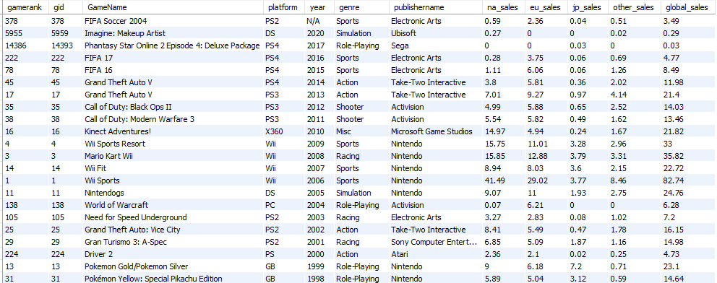
QUERIES:
Display top game in Europe by year
Notes:
Briefly explain the function and evaluation

Slide 34
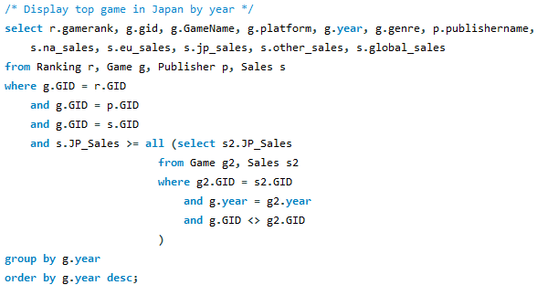
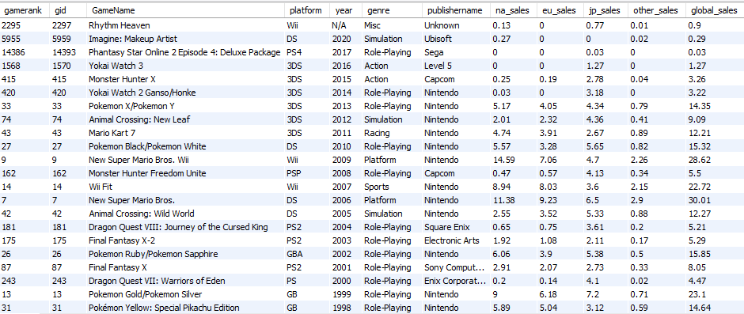
QUERIES:
Display top game in Japan by year
Notes:
Briefly explain the function and evaluation

Slide 35
Architecture Diagram
APPLICATION
GUI Objects for user to interact
User Triggers
extends
Triggers
CONTROLLER.JAVA
Create controller class for establishing connection between JavaFX and MySQL
Use JDBC driver manager and JDBC driver to interface
Create new connection object
Creates all Buttons, Event Handlers, other GUI functionalities for user to interact on scene
MAIN.FXML
Call FXMLoader to implement SceneBuilder
Handles
Interfaces
(JDBC)
VideoGameSales.db
Stored Procedures
MySQL Queries
calls
Query and modify DB
Game.java
Game class for creating game objects with all attributes → represents a game in DB
Return query results
Pass args to create Game Objects
Return Game Objects to Control Flow

Slide 36
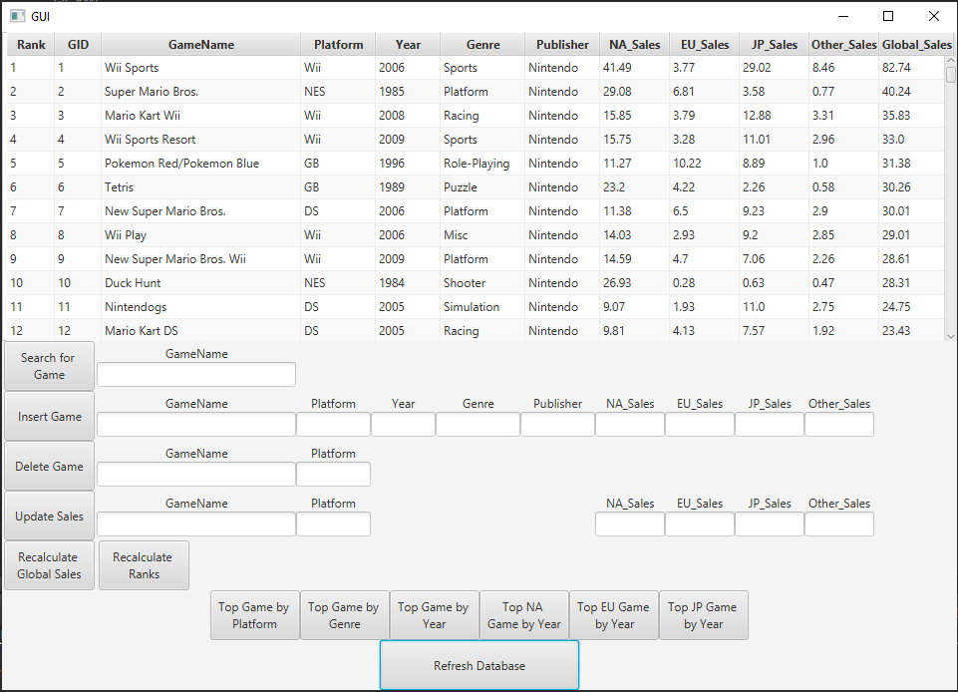
FRONT-END DEMONSTRATION

Slide 37
Conclusion
Back-end:
Broad/comprehensive overview of all the topics we had learned throughout the semester.
i. Develop ER & relational schema from a given dataset
ii. Normalize our data to eliminate data anomalies and duplicate data.
iii. Think as DB designers (queries) & DB implementers (B+Tree)
iv. How to implement queries and stored procedures efficiently
v. How data is internally indexed/organized in the back-end by B+trees

Slide 38
Conclusion
Front-end:
i. Learned GUI design & implementation
ii. Think from the user’s perspective → Considering functionalities a typical user might need
iii. Interface GUI (JavaFX) with DB
iv. Learned to call queries and stored procedures from Java
v. Enhance UI/UX
vi. Communication skills and teamwork through modularization and incremental design.

